Slide 1

Tribhuvan University Faculty of Humanities and Social Science Mechi Multiple Campus
Project on
“MMC Blog and Notice System”
Submitted By:
Ashish Neupane
6-2-0002-0004-2017
Pramisa Poudel
6-2-0002-0023-2017

Slide 2
Introduction
The MMC Blog and Notice System is a system that manages notices and blog of the college.
Allows general users to get information through mobile app.
Blog contains the information about various things related to Technology, Education, News, Articles, Sports, Entertainment and ongoing college activities.
Helps to create notices about leave, routines of the exam, results, vacations, public holidays, other extra-curricular activities etc.
Users can comment out on various notices.

Slide 3
Problem Statement
Most educational institutions manually create their notices by using paper based system and human resources to work on it.
All institutions create notices manually and stores at notice board which may not be accessed by all students.
The main problem that occurred during the project is to create and maintain the databases of different entities involved in this process

Slide 4
Objective
To develop a web based system and mobile application that allows users to create, view and maintain the notices of the college.
To develop the blog of the college, where we can post anything related to college.

Slide 5
Scope
Producing notices.
Collect, transmit, process, storage, maintenance and update the information etc.
Manage the information about notices and blog created within the structure of our college.
Responding to inquiries.

Slide 6
Limitation
Connection to the internet is mandatory,
It requires computer and mobile literate personal,
Only teachers, students and other staff are allowed to login to the system.
It requires smart phones.

Slide 7
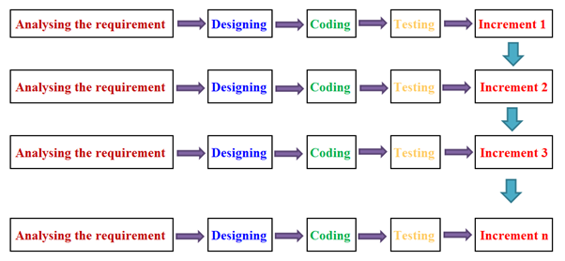
Methodology
We have chosen Incremental Method for developing our system. Incremental Model is a process of software development where requirements divided into multiple standalone modules of the software development cycle.

Slide 8
Background Study
This is the document of the project for developing a Notice and Blog system for colleges.
It consists of the current background of the college and problem having due to present system and now we are going to overcome those matters through this proposed system.
The teachers and students are using a manual and traditional file-based system for their college related work.
Not well secured there is a probability of getting damaged due to fore or any kind of physical harm.

Slide 9
System Analysis
Requirement Analysis
Functional Requirement:
System should be able to keep records of notices which are posted by teachers.
The users can post notices or important information regarding college.
Users can search notices or any information at any time.
Notices can be updated and deleted.
Users can get articles about college.

Slide 10
Requirement Analysis
Non Functional Requirement:
Availability.
Even if the system unexpectedly gets crashed data of the system will not be lost.
Security
Unauthorized access in the departmental store management system is restricted.
Reliability
Simple user interface and help function makes this system less training time to use.
Standards Compliance

Slide 11
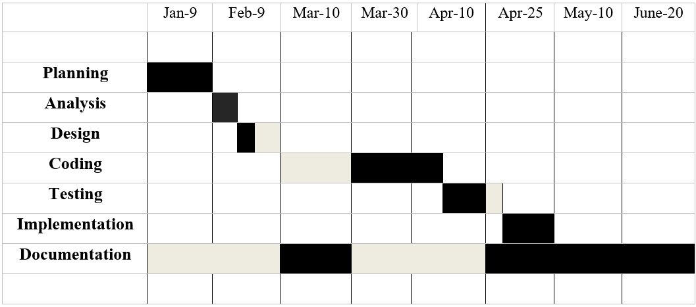
Feasibility Analysis
Figure Gantt Chart of Ashish Neupane

Slide 12
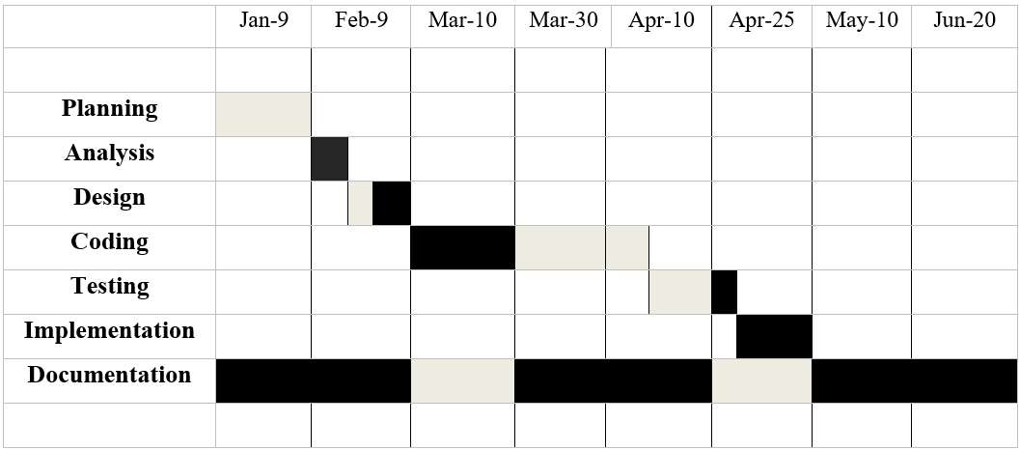
Figure: Gantt Chart of Pramisa Poudel

Slide 13
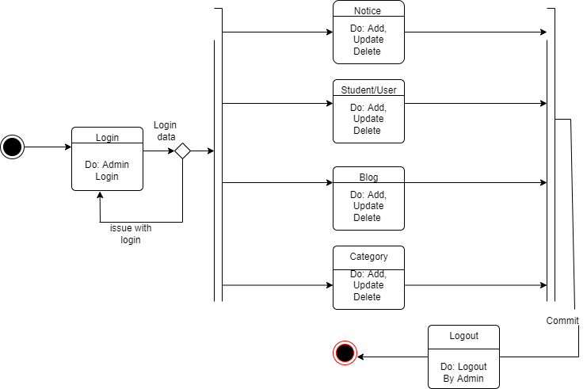
State Diagram of Admin

Slide 14
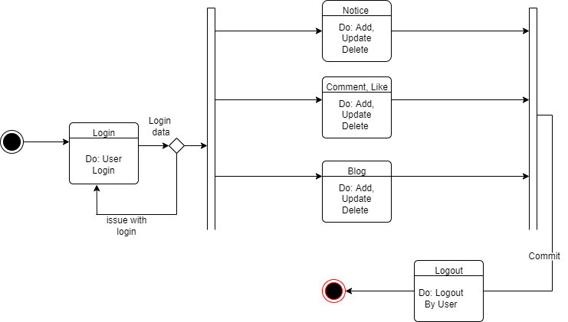
State Diagram of User

Slide 15
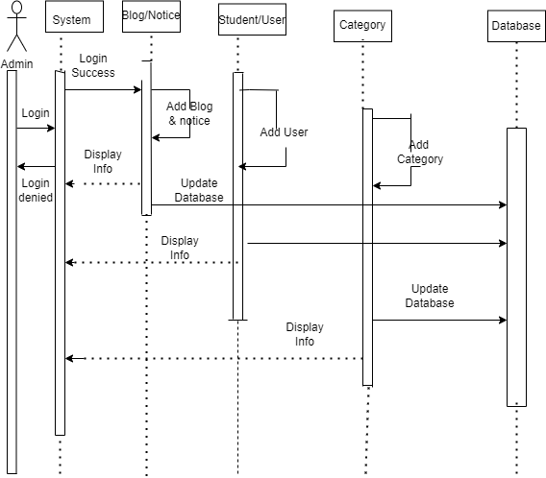
Sequence Diagram of Admin

Slide 16
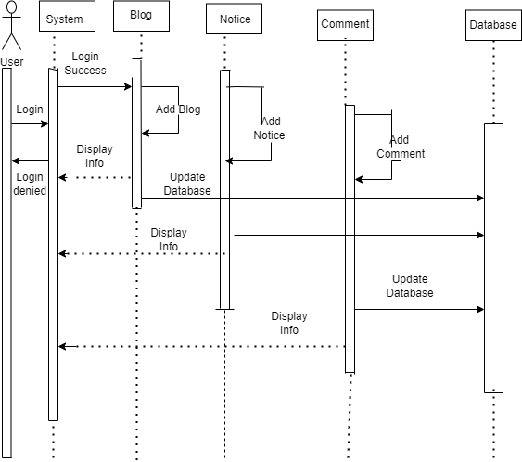
Sequence Diagram of User

Slide 17
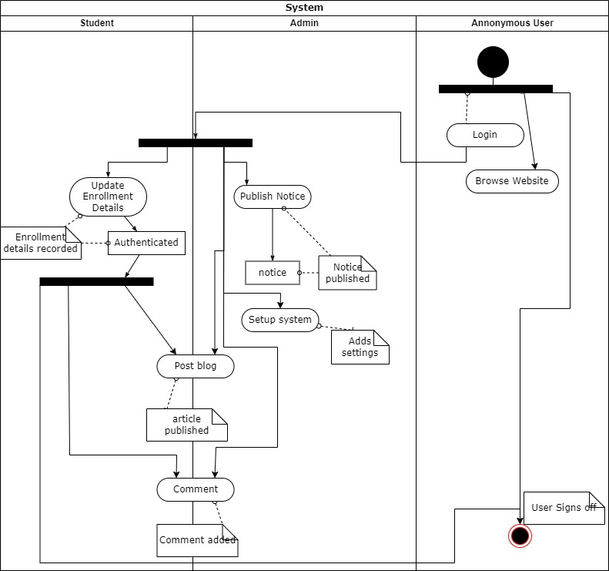
Activity Diagram

Slide 18
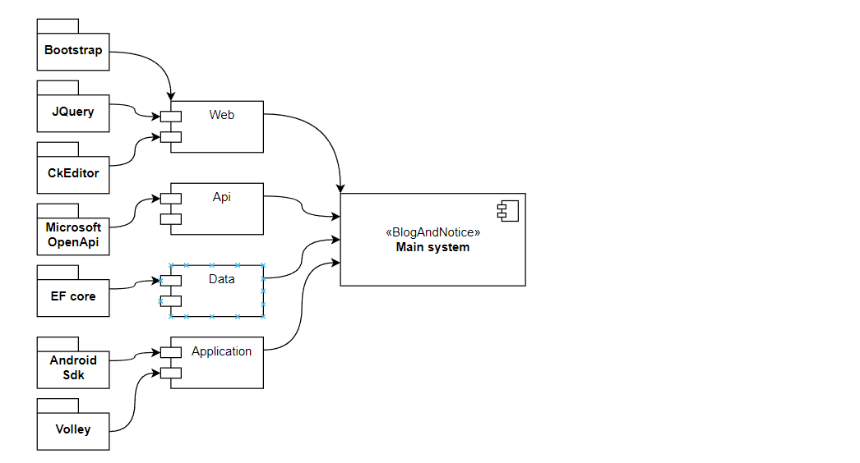
Component Diagram

Slide 19
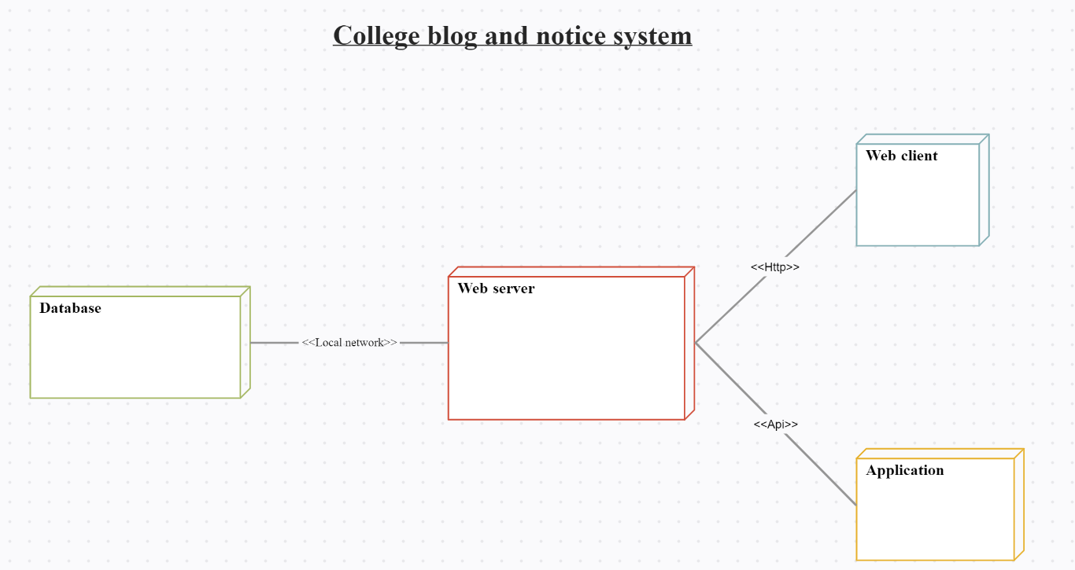
Deployment Diagram

Slide 20
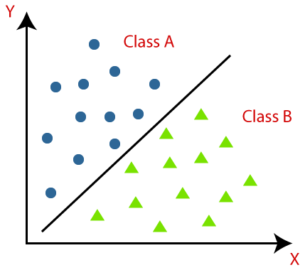
Algorithm Details
We used Machine Learning Algorithm(classification algorithm) for predicting appropriate comments.
This algorithm is based on a training dataset before receiving a test dataset. The algorithm is executed while submitting the comment.

Slide 21
Conclusion
The Project in Mechi Multiple Campus is an opportunity to develop and enhance technical knowledge for the growth of a career.
The real-world implementation and challenges are known and the technical implementations are no more jargons to those who utilize the internship period as a good platform and opportunity.
The developed system can provide basic information regarding the organization which generates more useful methods on the basis of giving the newly updates information provided by the organization.

Slide 22
Learning Outcome
Allow campus staffs to login
Allow logged in users to post notices and comment
Display notification on application user’s devices as soon as a notice is posted
Allows logged in users to post blogs
Allow web users to post articles in the blog
Allow users to perform above task through mobile device

Slide 23
THANK YOU !

